Slide 1
Sportsdoc
⚽️ 🏀 🏈 ⚾️
“A new way to sport”

Slide 2
Team Members

Slide 3

Enrico Blackwell

Slide 4

Willem Scott

Slide 5

Sayed Abdulmohsen Alhashemi

Slide 6
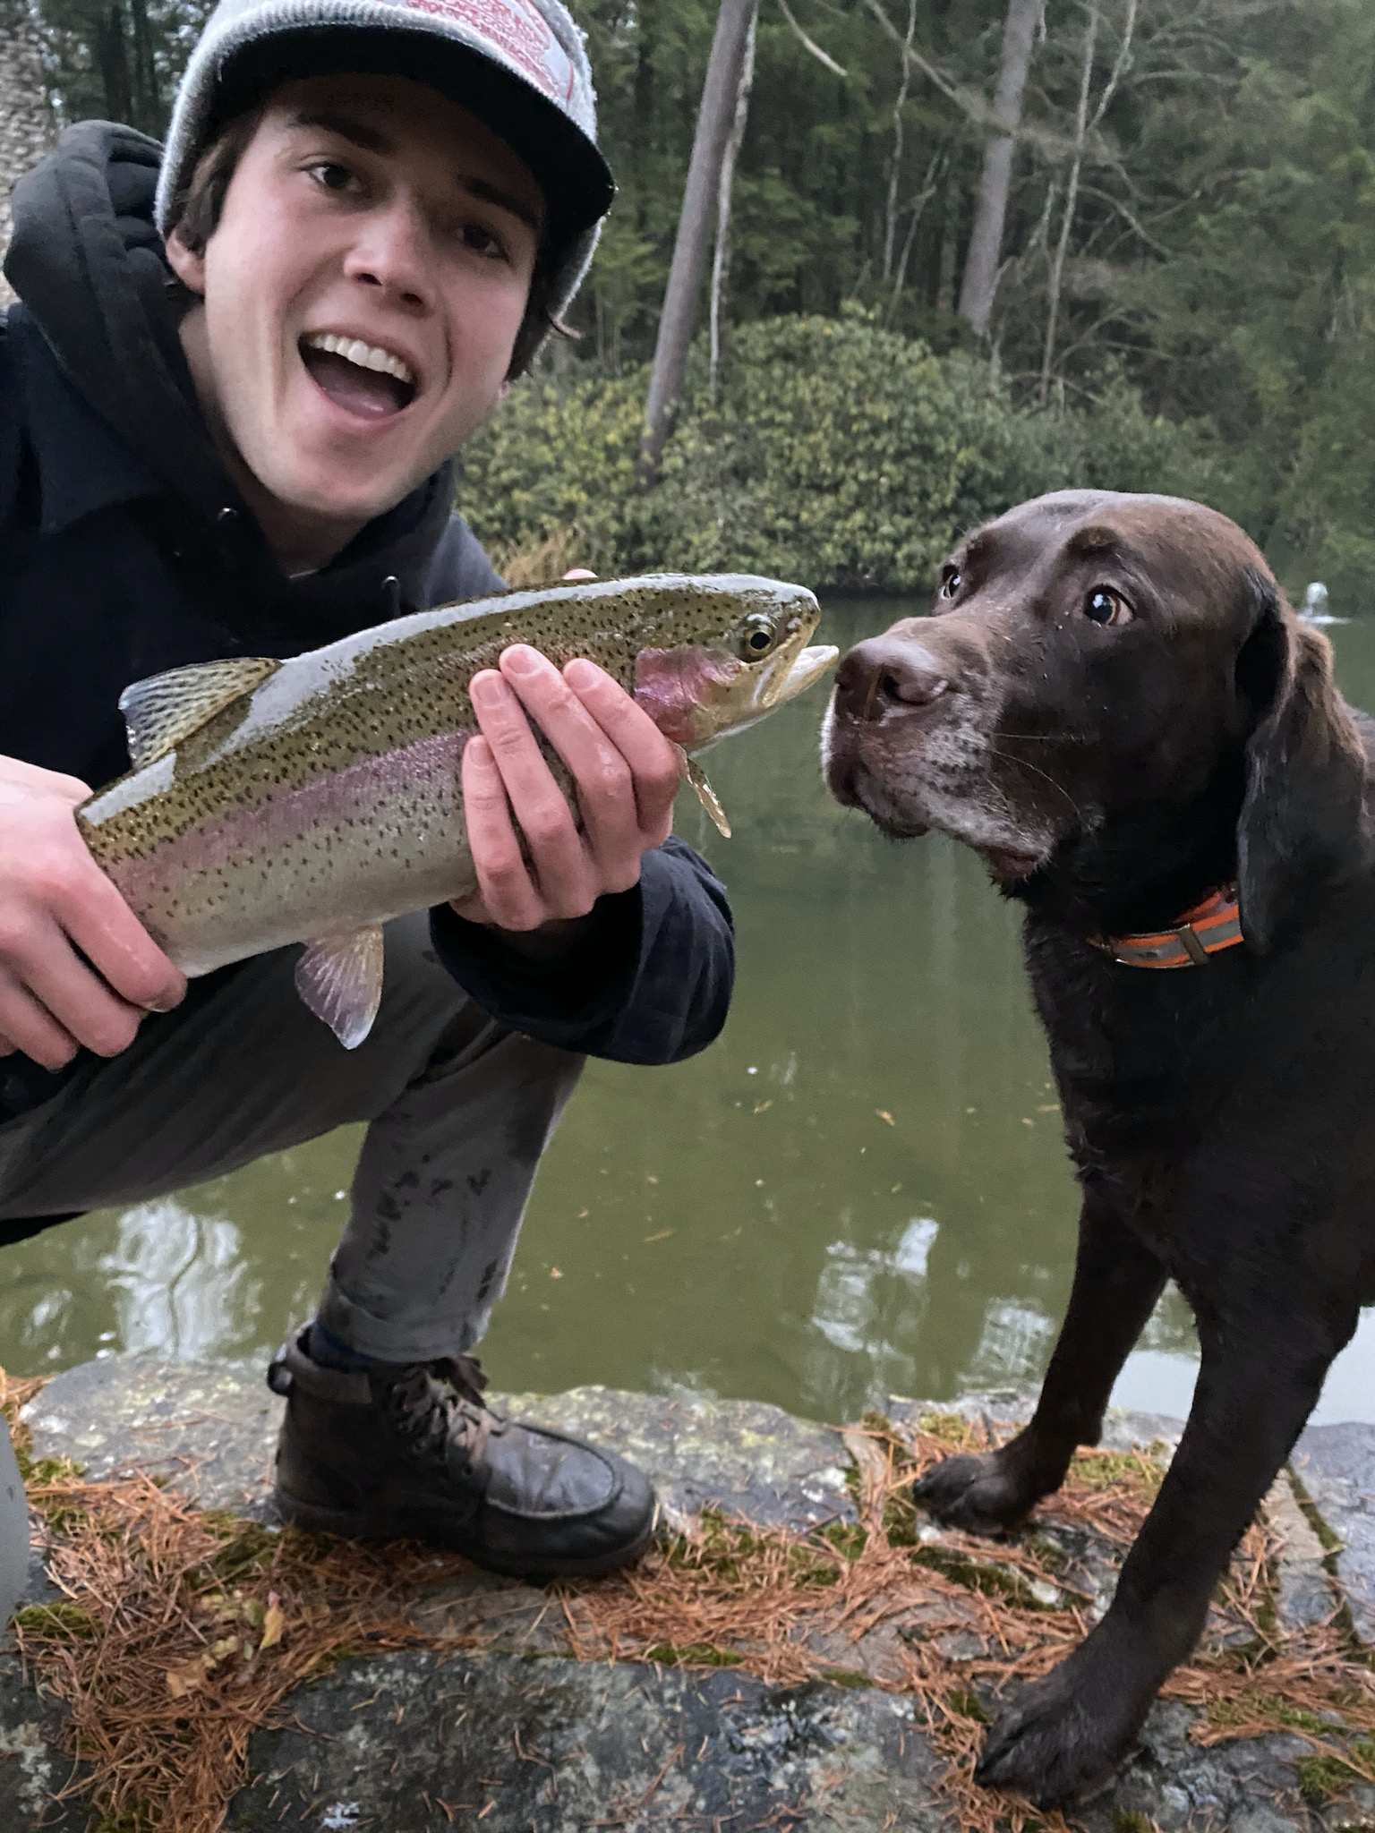
Evan Swett

Slide 7

Julian Abam

Slide 8
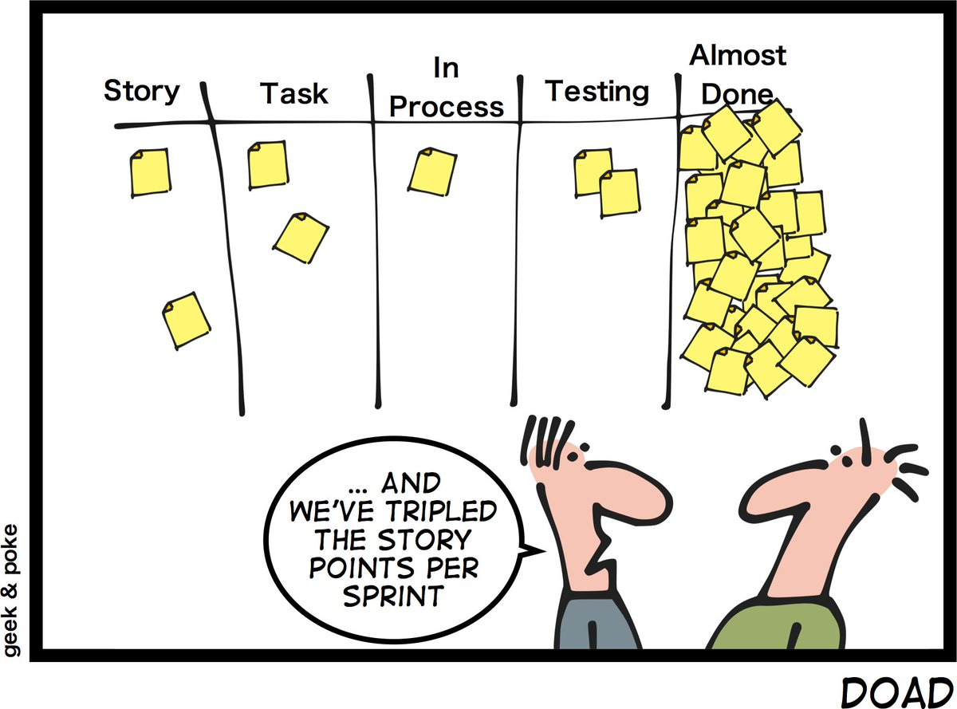
AGILE Manifesto
In order to successfully complete the project, the group utilized the AGILE Manifesto strategy. Between the five of us, there was an assigned frontend/design team, a backend team, and and an algorithmic design team. For every week there were assignments set per team in order to complete the project as efficiently as possible. The group rates this tool with a 5/5, as it provided a very organized way for us to iterate through goals and ideas.

Slide 9
Tools Used

Slide 10
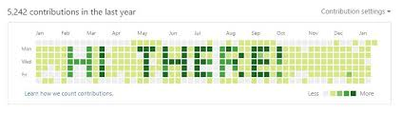
Github
The team utilized the Github project board in order to track team progress. For every week, there was a column set aside with particular task cards that needed to be completed for each week. Along with that was a column for work ‘in progress’ and a column for ‘done’ cards. As the team made progress, cards were appended into either category column as necessary. The group rates this tools with a 5/5.

Slide 11

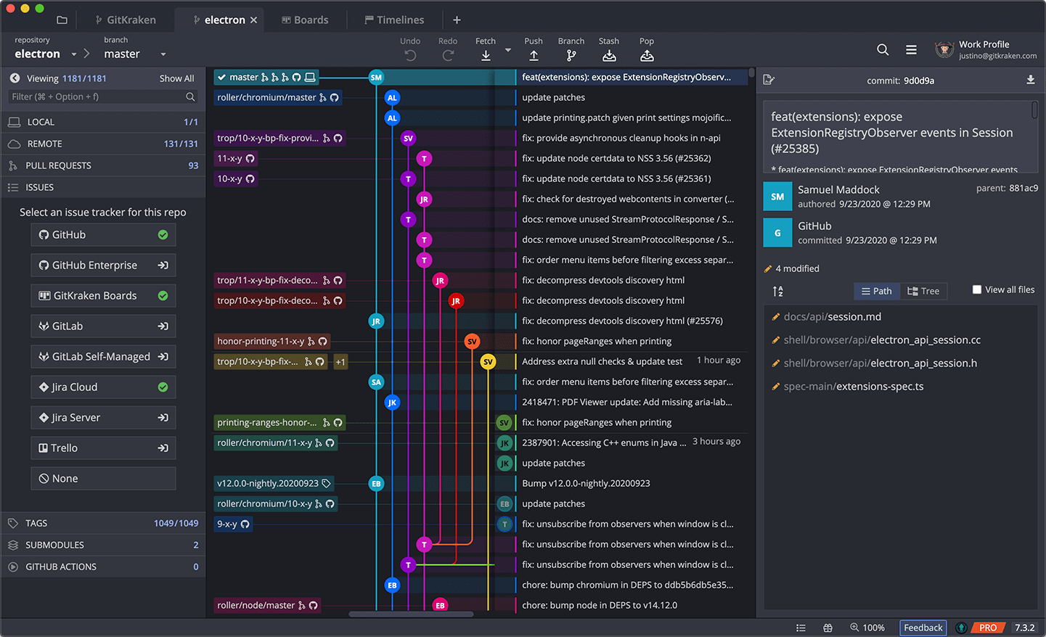
GitKraken
GitKraken is a graphical user interface (GUI) for Github. The group used it to more easily track each others’ changes to the project. The group gives it a 5/5 for its incredible functionality and its sleek design. Features include: visual commit history, drag and drop commits click to undo or redo changes, and merge conflict editor built-in code editor.

Slide 12

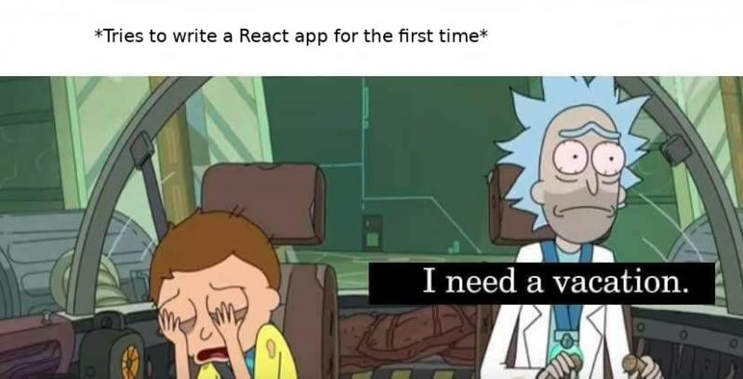
React
The group utilized React in order to handle and stylize the front end system of the application. React created an efficient way for the group to implement a stylish and informational UI into the project. The group rates this tool with a 5/5 as it enabled us to customize the application to our exact specifications.

Slide 13

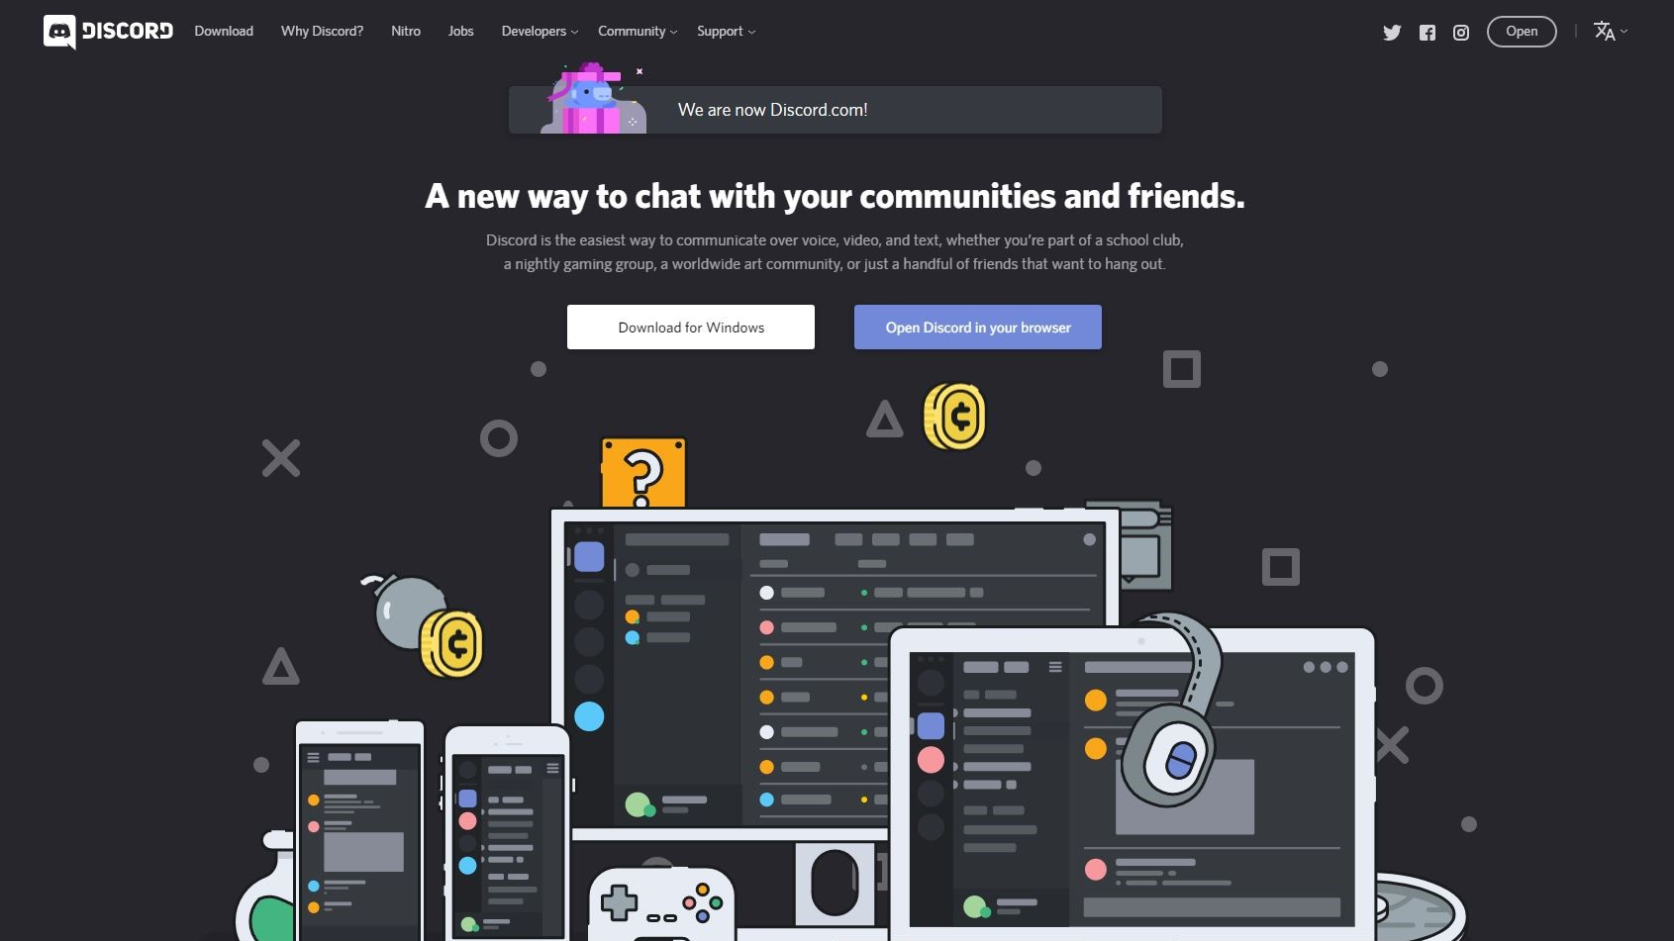
Discord
Discord served as a great tool for the group to communicate by both text and video. The group rates this with a 5/5.

Slide 14
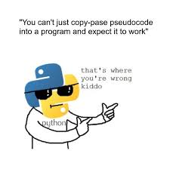
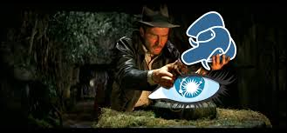
Python & PostgresQL
Python served as a very important tool for the group. Through the use of the API’s we were able to gather the data required to populate the database. From there, the group populated the PostgresQL database with the API information. The group rates Python with a 5/5 and PostgresQL with a ⅗. Some challenges faced included getting accurate coverage over long time spans, especially with error handling. Also, random errors would occur midway through and we had to find how to move forward without wiping what we had already.

Slide 15

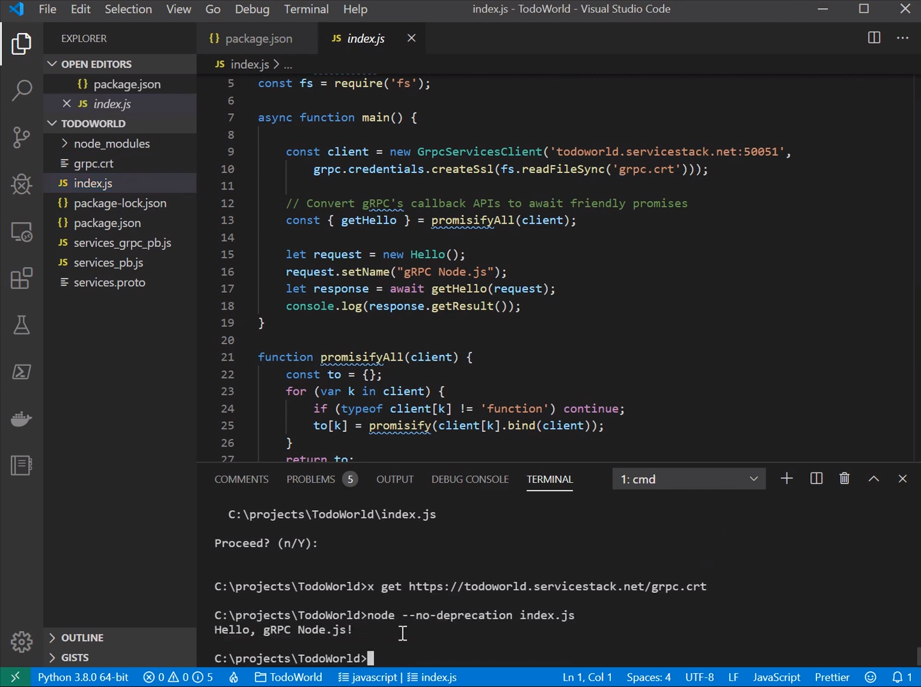
Node.js
The group used Node.js to host our application outside of the web server. The group rates this with a 5/5 as utilizing this tool served as very efficient when running/building the app.

Slide 16

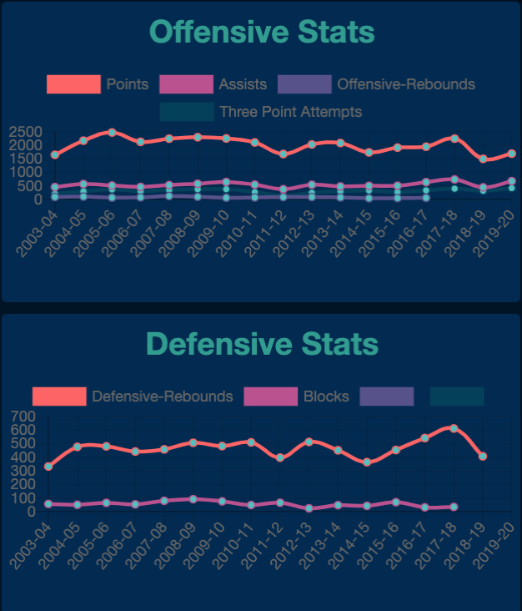
Chart.js
The group used version react-chartjs-2 to implement React as a wrapper for the charts. We give it a ⅘ score as it was difficult to use with React.

